Slide 1
NHL Player Salary Machine Learning Model
Contributors: John Gaffney, Kazuki Takehaski, Patrick Thornquist

Slide 2

Core Message
Our goal is to use machine learning to determine which NHL contracts are under and overvalued.
We can then use this data to guide us with setting a lineup in Daily Fantasy sports, in the hopes of gaining an edge on competition to earn more gambling profits.

Slide 3
Model Summary
Supervised / Regression
Unsupervised
Linear Regression
Lasso
Huber Regression
Decision Tree Regressor
Neuro network
K-Means / Clustering

Slide 4
Data Cleanup & Model Training

Slide 5
Data Collection & Cleanup
We used hockey-reference.com to source our data. This site allowed us to download two CSV files, one with statistics for all players in the 2021-22 season and the other with contract data.
The next step was to join these two CSV files together using an outer join. With under 1000 players to collect data from, we didn’t want to limit our dataset too much.
After completing the join, we still needed to manually correct or update several rows, however, the majority were of the information was joined correctly. We also manually removed goalies from this dataframe.

Slide 6

Problems with Cleanup
Some names were “First Last”, some were “Last, First”. Our code corrected most, but not all.
Slight name differences between the 2 CSV files…”Zach vs. Zachary”, “Matt vs Matthew”, etc.
Nicknames
Foreign names…Teuvo Teräväinen. The extra grammatical features were not picked up, confusing the join.

Slide 7
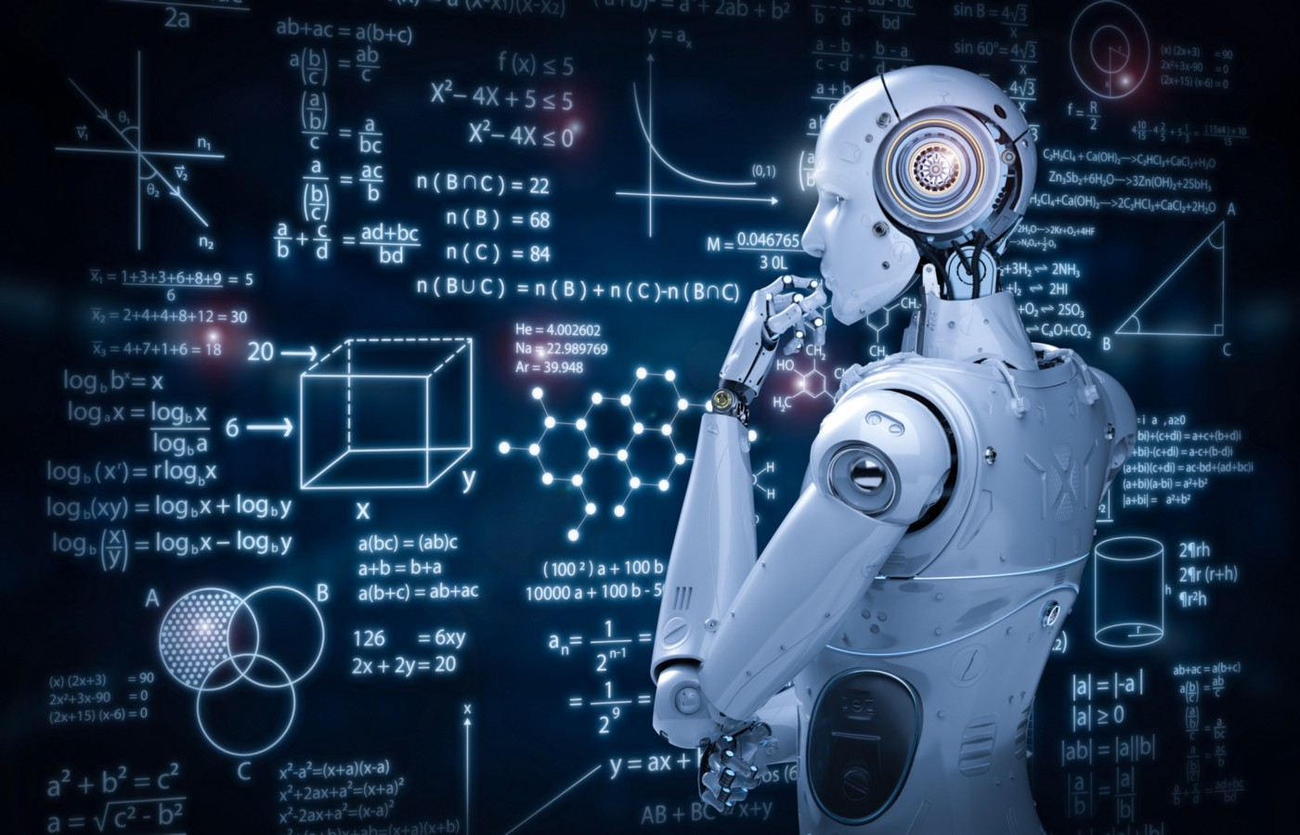
Problems with Model Training
At first, we were treating regression models like classification models. This led to empty values and always returned a loss of 1.
Preparing the features model was difficult. It required more imports, not all of which worked as expected.

Slide 8
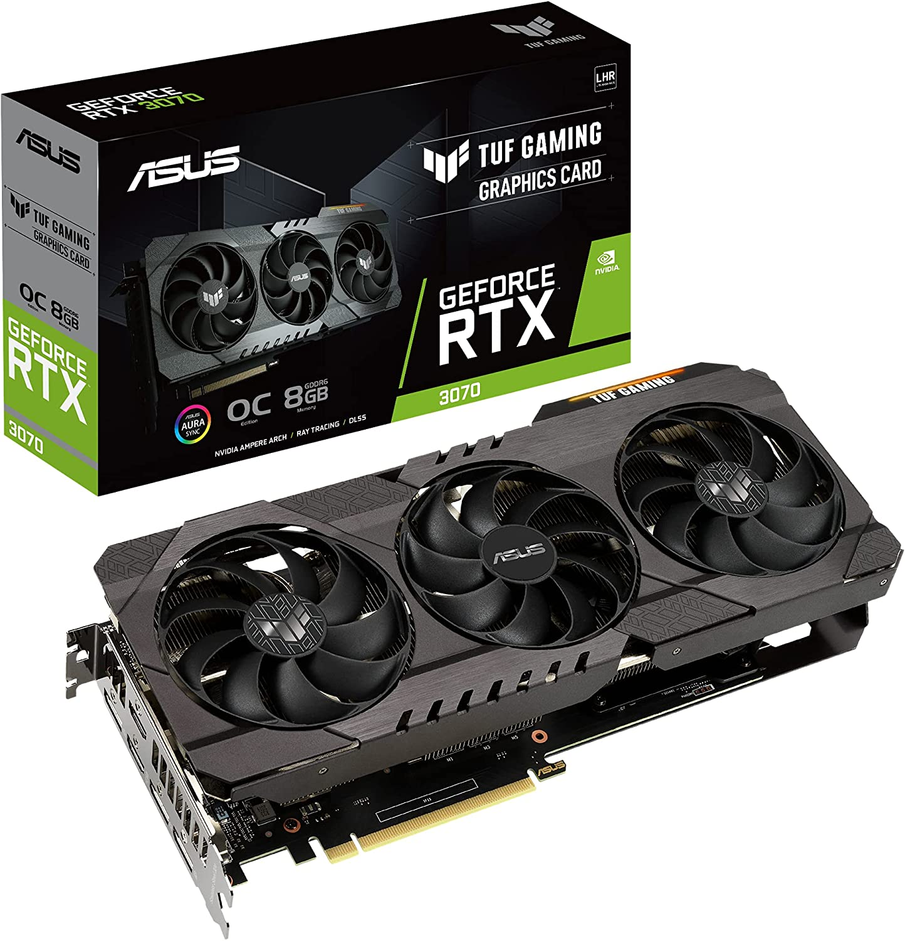
Model Training Process
We trained using a variety of models, which allowed us to compare results to determine which would be the best.
We also tinkered with the variables, changing the number of nodes and hidden layers to examine the differences.
Luckily, John was running a GPU (GEFORCE RTX 3070), which significantly sped up the model training process.

Slide 9
Model Evaluation

Slide 10
Evaluation Techniques

Slide 11
Results (table of all results)

Slide 12
Add 3 slides of the best results
Model sufficient for predictive task? If not, why not? What inferences or general conclusions can you draw from your model performance?

Slide 13
Questions that remain

Slide 14

Q & A

